Slide 1

HotelRevAI — AI-Driven Revenue Analysis for Hotels
Milestone 2: Data Loading & Modelling. Using Power BI to transform booking records into interactive dashboards that reveal revenue drivers, booking patterns, and cancellation impact.

Slide 2

Project Abstract
Analyze hotel bookings to identify revenue trends and performance. Data cleaning and preprocessing fed Power BI dashboards that visualize total revenue, monthly trends, occupancy proxy, ADR, and cancellation rate to inform management decisions.

Slide 3

Problem Statement
Hotels struggle to interpret large volumes of booking data to spot peak seasons, top revenue sources, and cancellation effects. This project uses Power BI to create interactive visualizations that make patterns and impacts obvious for decision-making.

Slide 4
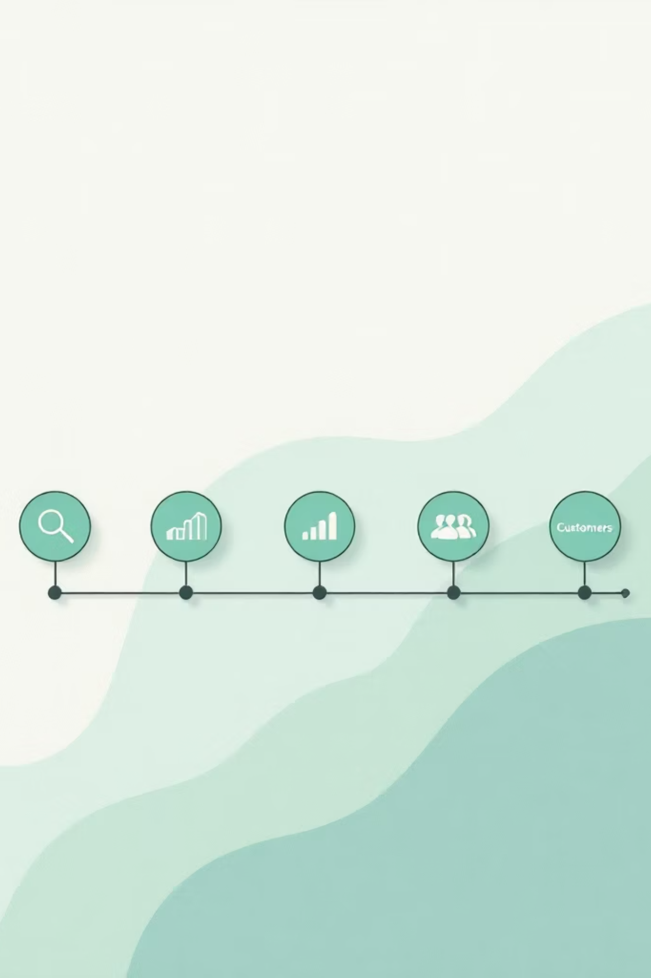




Objectives
Revenue Trends
Analyze overall revenue performance and growth over time.
Performance Metrics
Evaluate ADR, cancellation rate, booking nights, and guest counts.
Customer Behavior
Segment booking patterns by customer type, room type, and repeat guests.
Interactive Dashboards
Build Power BI dashboards with year filters and behavior charts for insights.

Slide 5

Data Loading & Cleaning
Imported CSV into Power BI. Used Power Query to handle missing/null values, correct data types, remove duplicates and irrelevant columns. Created calculated columns: Total Stay Duration, Total Guests, revenue measures, and unified arrival date column.

Slide 6
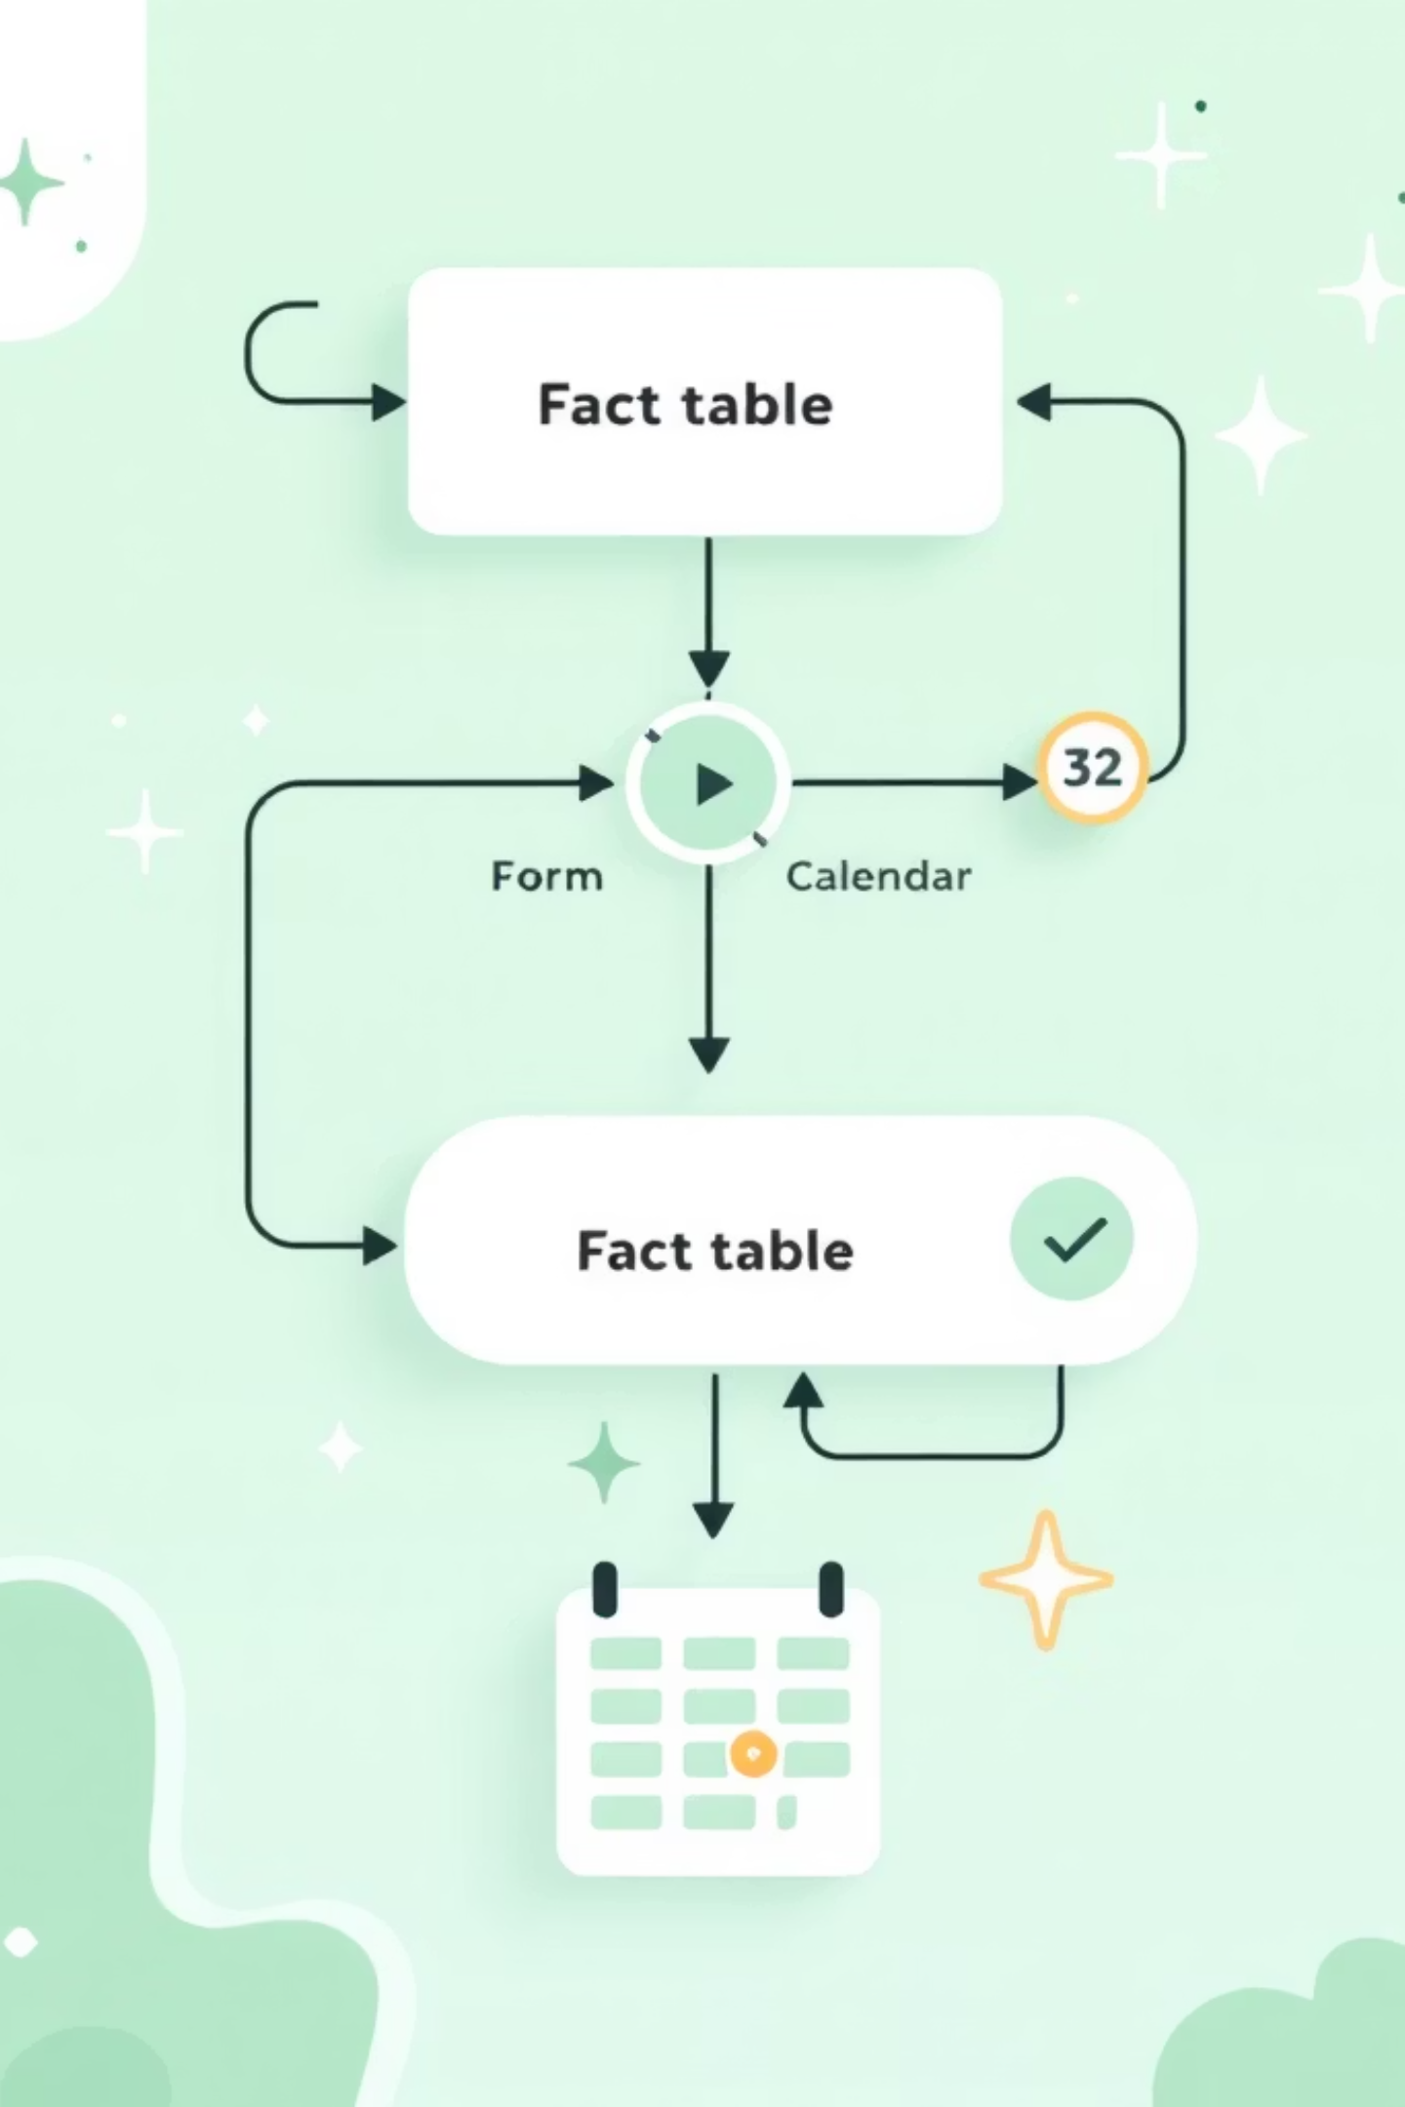
Data Modelling
Built a relational model to enable time-based analysis. Key components: Fact table (Hotel_Data), Calendar dimension (Date, Month, Year), and Measures table (d3_measures) holding DAX metrics for aggregation and filtering.

Slide 7
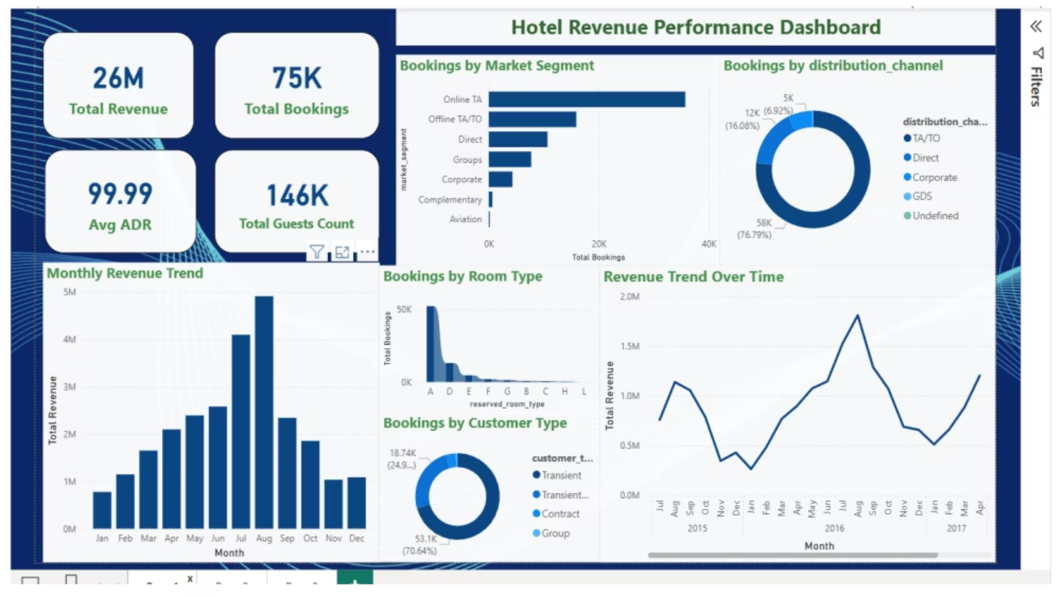
Dashboard 1 — Hotel Revenue Performance
KPIs: Total Revenue 26M, Total Bookings 75K, Avg ADR 99.99, Total Guests 146K. Visuals: monthly revenue trend, market segment distribution, channel donut, room-type demand, customer-type distribution, revenue trend peak in late 2016.

Slide 8
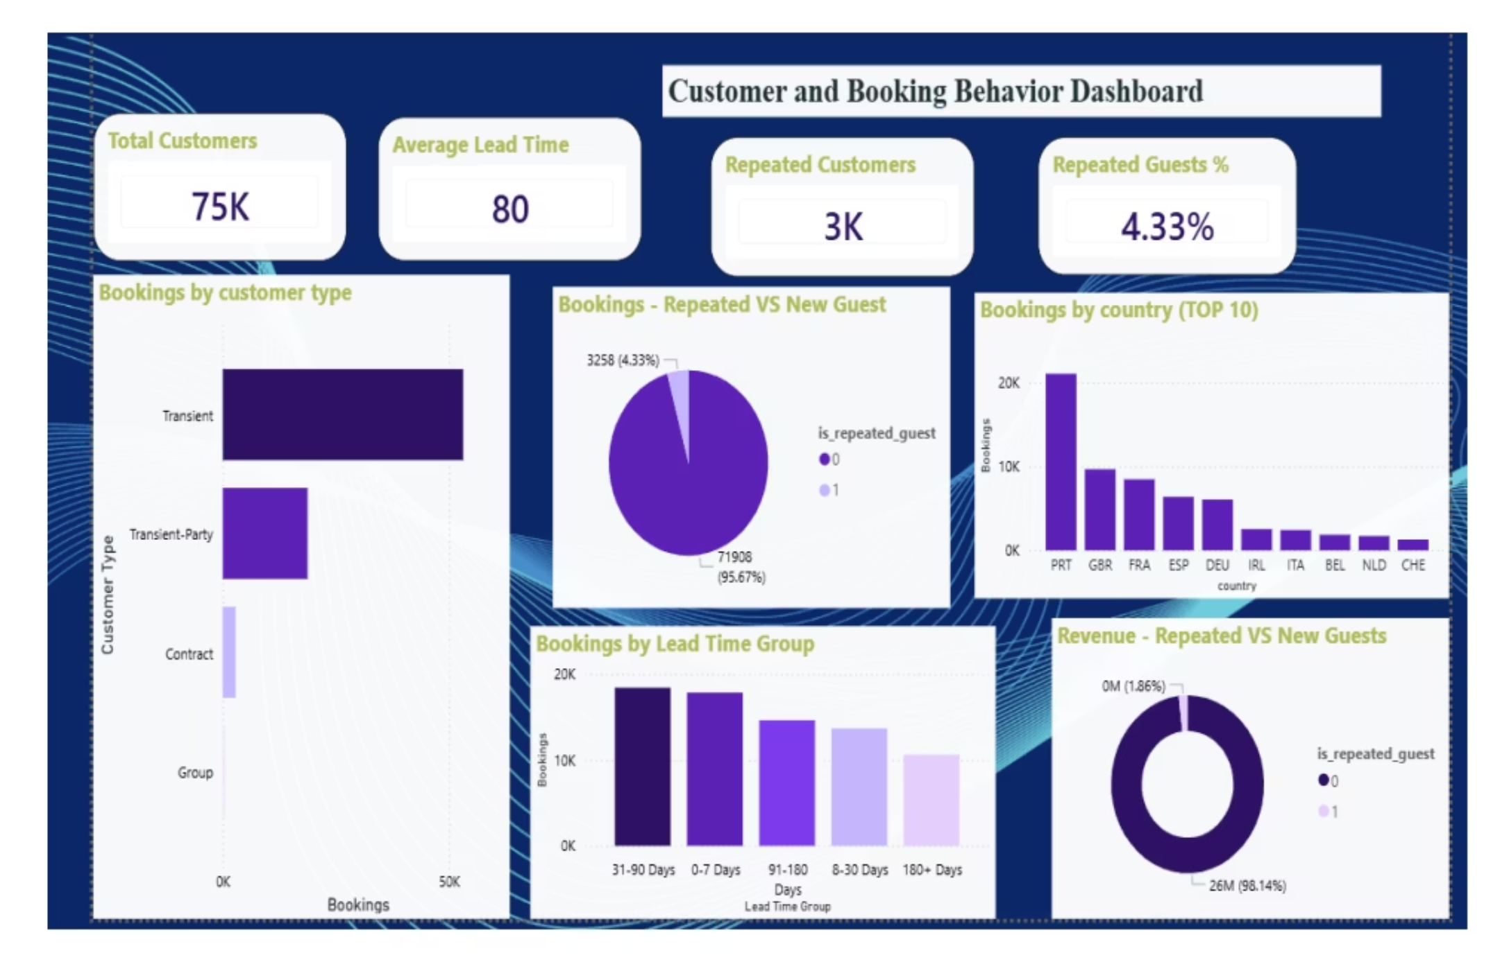
Dashboard 2 — Customer & Booking Behavior
KPIs: Total Customers 75K, Avg Lead Time 80, Repeated Customers 3K, Repeat % 4.33%. Insights: strong new-guest inflow (95.67%), low repeat ratio, concentrated demand in countries (PRT, GBR, FRA, ESP, DEU), lead-time distribution skewed to early bookings.

Slide 9
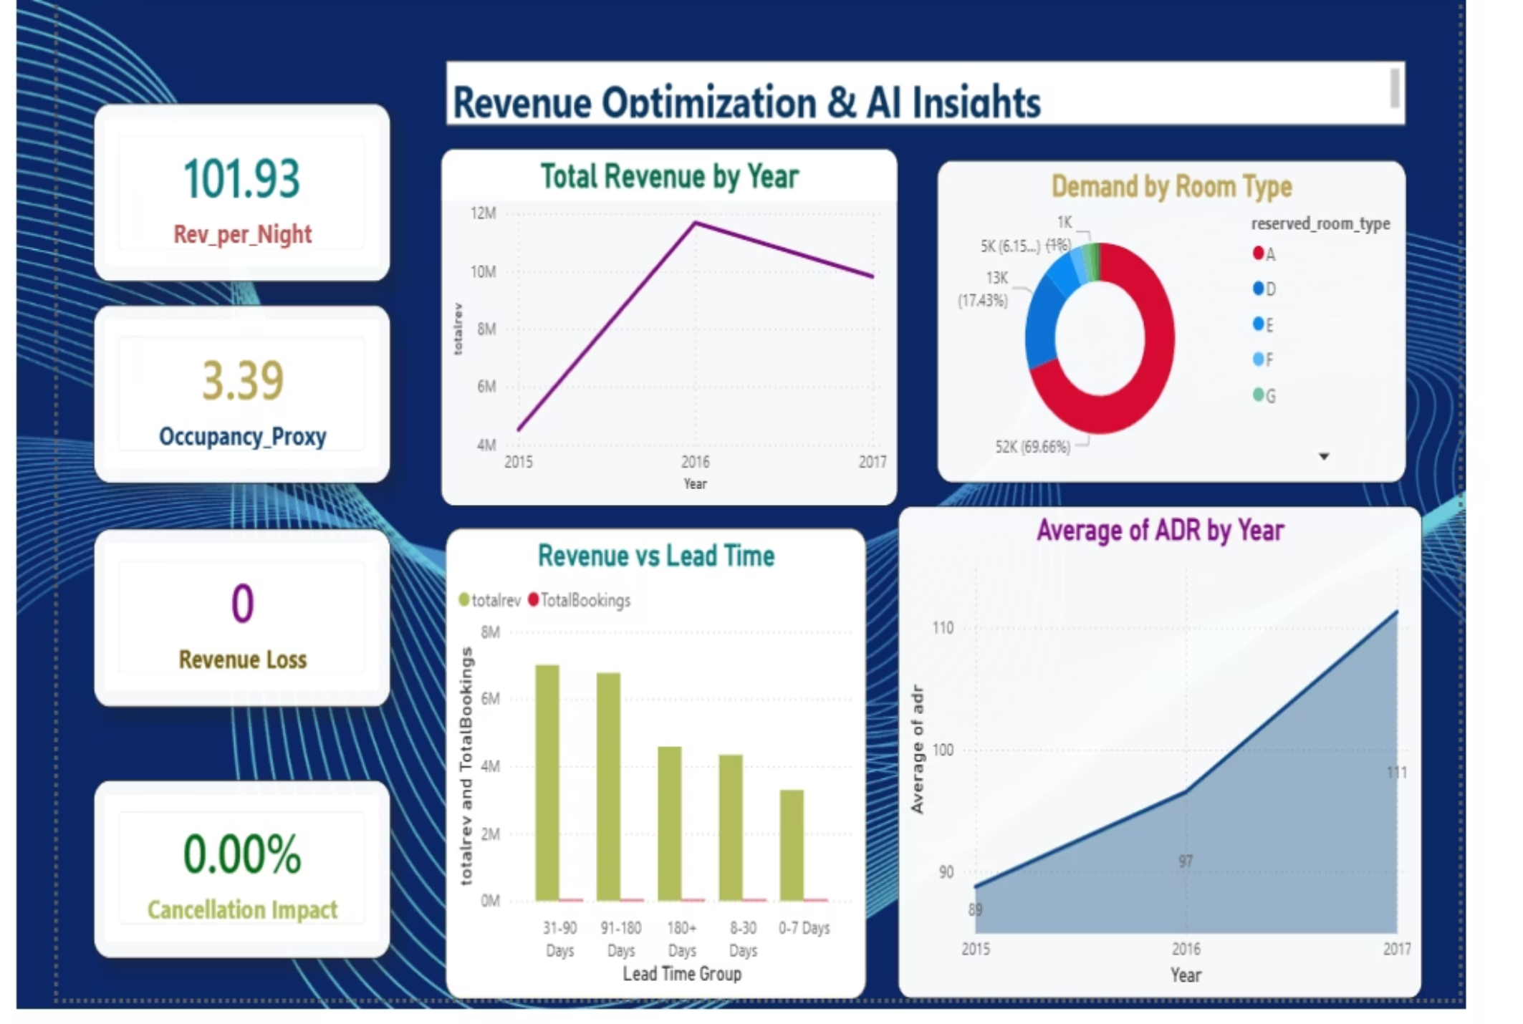
Dashboard 3 — Revenue Optimization & AI Insights
KPI highlights: Rev_per_Night ~101.93, Occupancy_Proxy ~3.39, Revenue Loss 0, Cancellation Impact 0.00%. Visuals: Total revenue by year, Avg ADR by year (2015:88, 2016:97, 2017:111), revenue vs lead time, demand by room type (A–G evenly distributed ~17.4%).

Slide 10

Conclusion & Business Value
Reliable Foundation
Actionable Insights
Data loading, cleaning, and modelling established a dependable analytics base.
Dashboards surface seasonal patterns, channel reliance, customer mix, and cancellation impact.
Revenue Decisions
Findings support pricing policy adjustments, targeted marketing, and booking management to maximize revenue.
HotelRevAI demonstrates how Power BI and careful modelling enable data-driven strategies to improve operational efficiency and revenue performance.

